Slide 1


Team Phantom
Bid Presentation for:
Tag Cloud

Slide 2
Team Members
& Main Roles*
Tim Allman – Team Leader
Adam Stafford – Designer
Robert Cole – Coder
& Documenter
Tuilla Chaves – Tester
* Where possible all team members will share the workload equally, however members will be responsible for items falling under their main role. I.e. The chief coder is responsible for the overall code.

Slide 3
How were Roles assigned?
We considered each member's skillset and assigned roles based on expertise and capability/desire.

Slide 4
The group decision making process is democratic, ensuring every team member has a say.
Decision Making and Dispute Resolution:
In the event of a 2 vs 2 impasse, the Team leader has the final decision.

Slide 5
Approach
Languages: c#, Javascript, HTML and PHP.
Why? All members are familiar with c# and its flexible for the project needs.
Platform: Google App Engine vs. Unity
Which? Unity because of 3D potential.
Stand-alone executable vs. Web app.
Stand-alone wins as it can be ported to a web app at a later juncture.

Slide 6
Design methodology?
Agile vs Rational Unified Process.
Agile wins because it's a perfect fit for the way we want to develop the project as a series of levels of functionality.
E.g. Integrate, test, integrate, test etc...

Slide 7
Core Input support for:
Microsoft word .doc files
Html/xhtml
Adobe PDFs
Additional Input options we would like to have:
Microsoft Office Support for .ppt and Excel and a text input form field

Slide 8
Functionality & Features
User Definable Colour schemes.
Multiple Font Styles.
Numerous Word Shapes & Layouts.
Words as hyperlinks
Control of Word filtering
Zooming, Dragging, Rotating.

Slide 9
Unique Selling Points
Ability to skim data from websites.
Support for Big Data.
Possibility of 3D Tag Clouds
Output as generic imgs eg. Jpg, gif, svg
Possible support for disabled people through word cloud narration.
Well Designed & Visually Appealing GUI

Slide 10
Testing Approach
Testing will follow the Agile methodology so testing will be fully integrated into each stage of the development cycle.
Integration testing & Unit testing after each milestone.
Usability Testing for the final deliverable

Slide 11
What use is it?
Educational Tool: Take the teacher's instructions doc or brief, put it into tag cloud and then match it with the cloud produced by the students submission to see if key points were met/exceeded.
Rough Visual Plagarism Checker

Slide 12
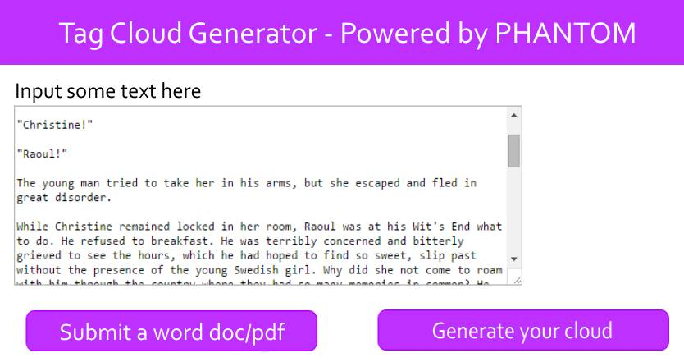
Example Mock Up 1:

Slide 13
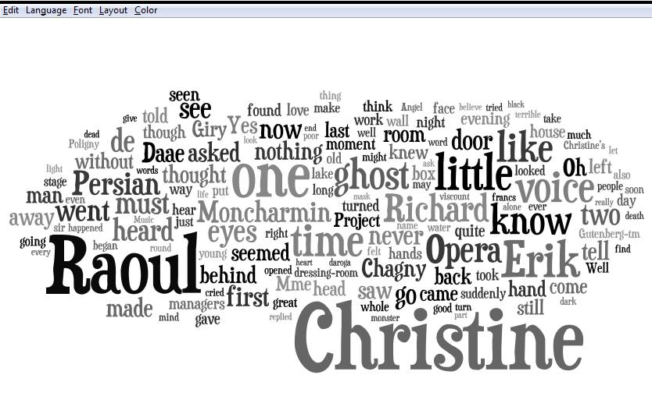
Example Mock Up 2:

Slide 14
Why Tag Cloud?
It's something different to usual projects.
Opportunity to learn/expand new skills.
Element of Challenge.
As a team we have a strong background in visual design coupled with excellent coding know-how.

Slide 15
Alternate Project Choices:
Taxi Dispatch & Booking System
E - Voting System

